Slide 1
Design Patterns
Under The Hood

Slide 2
Table of contents
01
02
Introduction
Visitor

Slide 3
01
Introduction
Before we start let’s setup the mind set

Slide 4
Design Patterns MindSet
You have all the time you need while coding, but once your work is published, the clock starts ticking.
This is why it's essential to understand design patterns and thoroughly explore the libraries you choose.

Slide 5
Let’s Make Simple TreeView
Cont. the composite tree that we did before how to do operations on it

Slide 6
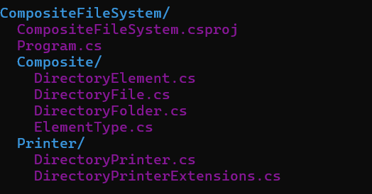
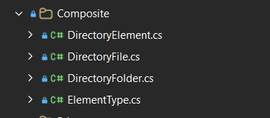
Let’s Make Simple TreeView

Slide 7
Gang Of Four Definition
"Compose objects into tree structures to represent part-whole hierarchies.
Composite lets clients treat individual objects and compositions of objects uniformly."

Slide 8
Gang Of Four Definition
Structural Pattern: The Composite Design Pattern is a structural pattern, meaning it helps in organizing and structuring objects to represent a tree or hierarchy.
Uniform Treatment: This pattern allows us to treat both individual objects (leaves) and compositions of objects (composites) uniformly.

Slide 9
Composite Use Cases
DOM (Document Object Model): Including the HTML DOM, XML DOM any document actually
OPENXML (Word,Excel,PowerPoint)
User Interfaces: To represent hierarchical views like menus and trees.
Angular: Angular Forms (FormGroup,FormControl)
C# Expressions: Linq IQueryable Is Based on Composite.
AST: Abstract Syntax Trees in many Languages (roslyn code analyzers)

Slide 10
Participants
Component: This is an abstract class/interface declaring common operations for both simple and complex objects in the hierarchy.
Composite: Represents complex objects that may have children (both leaves and other composites)
Leaf: Represents the simplest objects. A leaf doesn’t have any children.

Slide 11
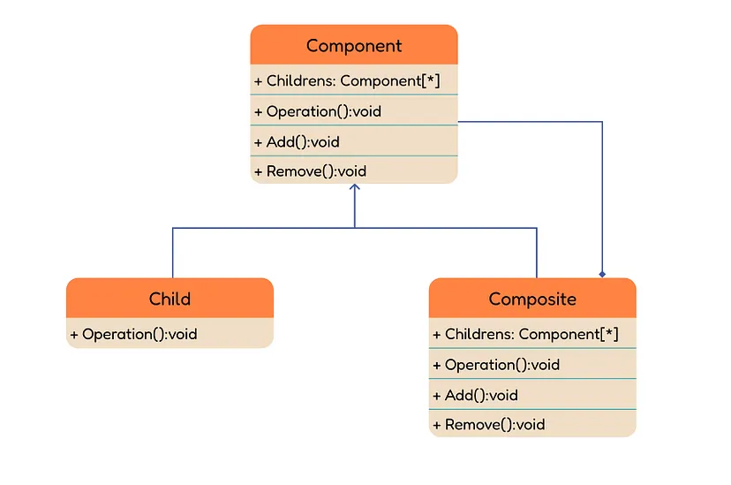
Composite

Slide 12
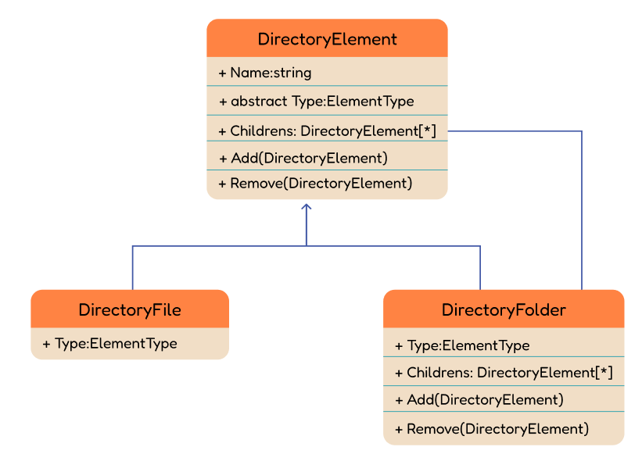
Lets Make Simple FileSystem (Composite)

Slide 13
Demo

Slide 14
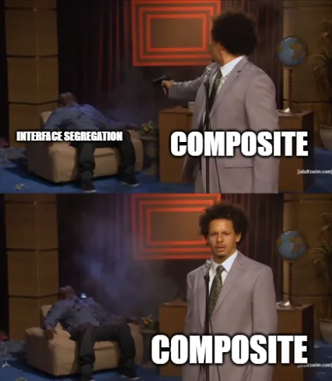
Wait what about SOLID
Interface Segregation Principle
The interface segregation principle states:
A client should never be forced to implement an interface that it doesn’t use, or clients shouldn’t be forced to depend on methods they do not use.

Slide 15
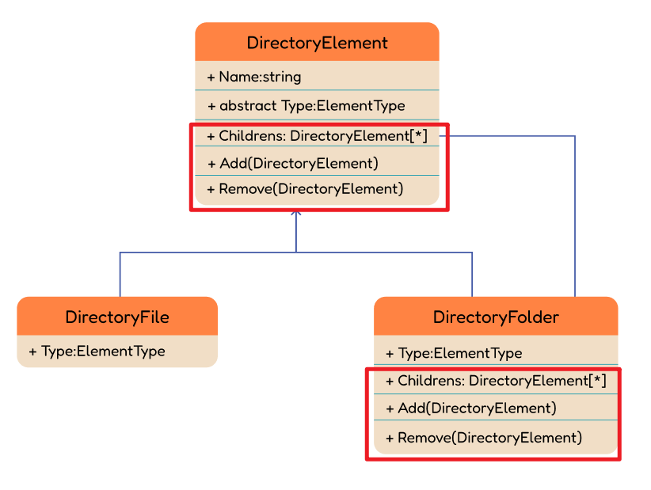
Wait what about SOLID

Slide 16
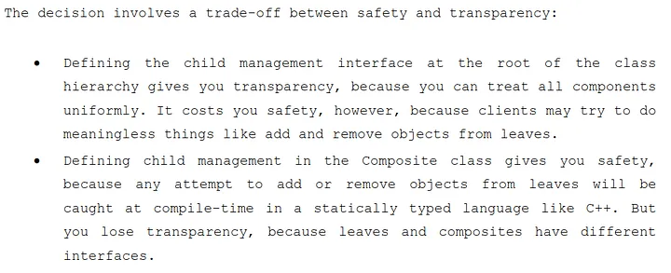
GOF book discussed this problem
GOF Book Page 187

Slide 17
Transparency Approach

Slide 18
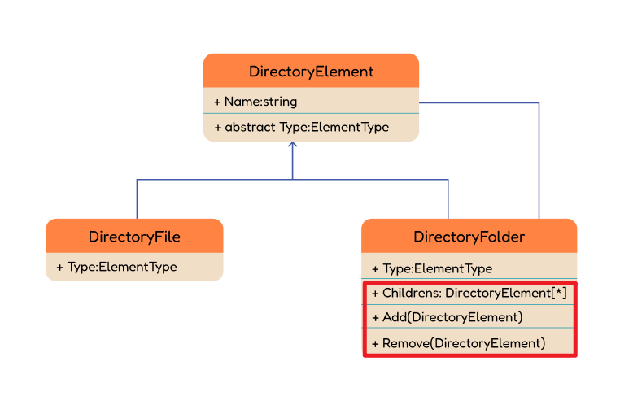
Safety Approach

Slide 19
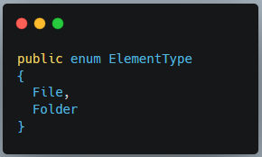
How To Get The Actual Type
Lets Add Simple enum identifier:

Slide 20
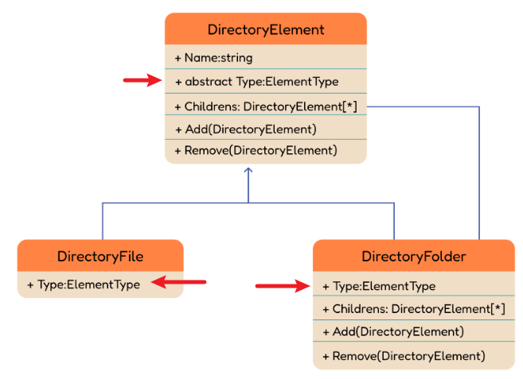
Identifier

Slide 21
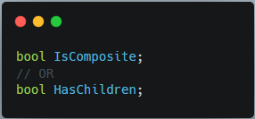
How To Get The Actual Type
Other Approaches :

Slide 22
How to develop HTML

Slide 23
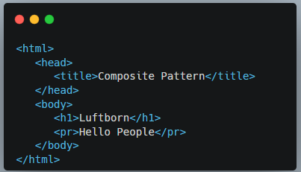

How to develop HTML
What to do
??

Slide 24
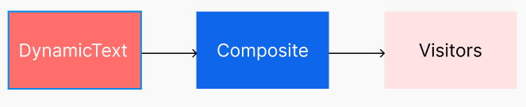
Common Practice :
SOOOOOON

Slide 25
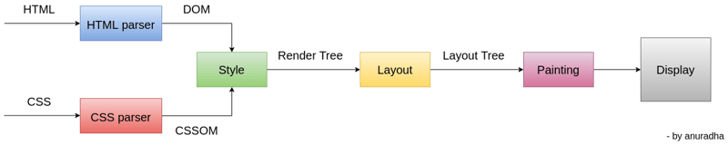
How to develop HTML

Slide 26
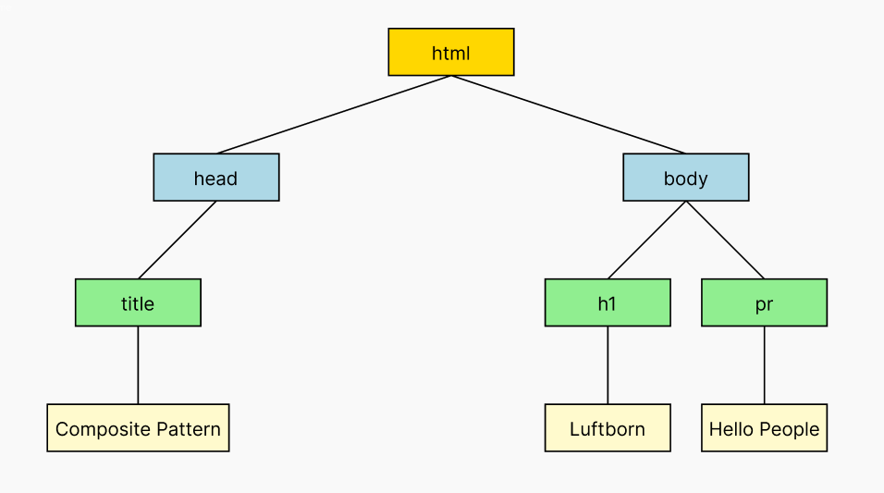
HTML DOM

Slide 27
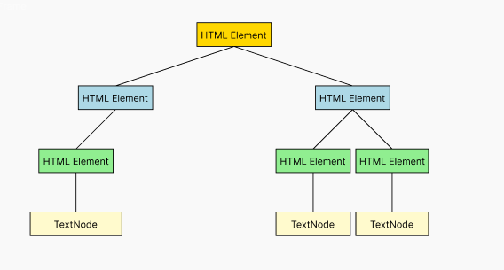
HTML DOM

Slide 28
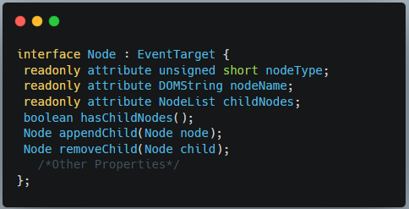
HTML NodeInterface

Slide 29
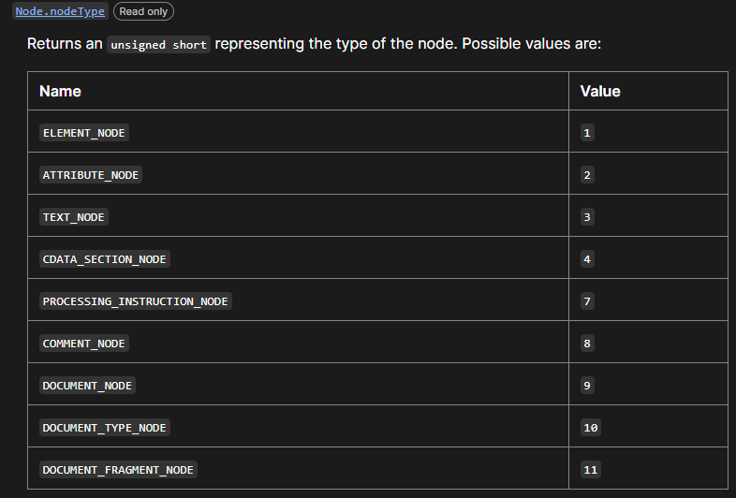
HTML DOM

Slide 30
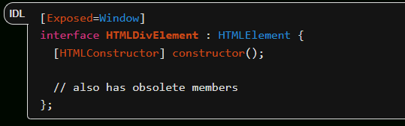
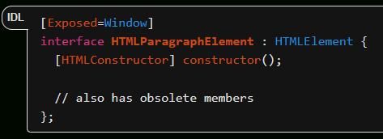
HTML Elements

Slide 31
Composite in C#

Slide 32
Why IQueryable
IEnumerable VS IQueryable

Slide 33
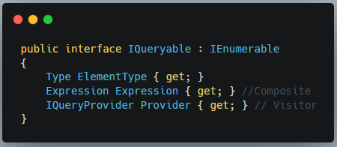
Why IQueryable

Slide 34
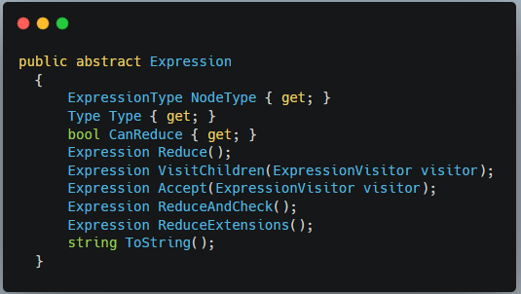
C# Expression

Slide 35
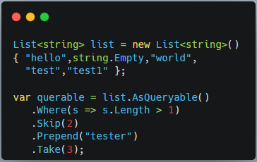
C# Example

Slide 36
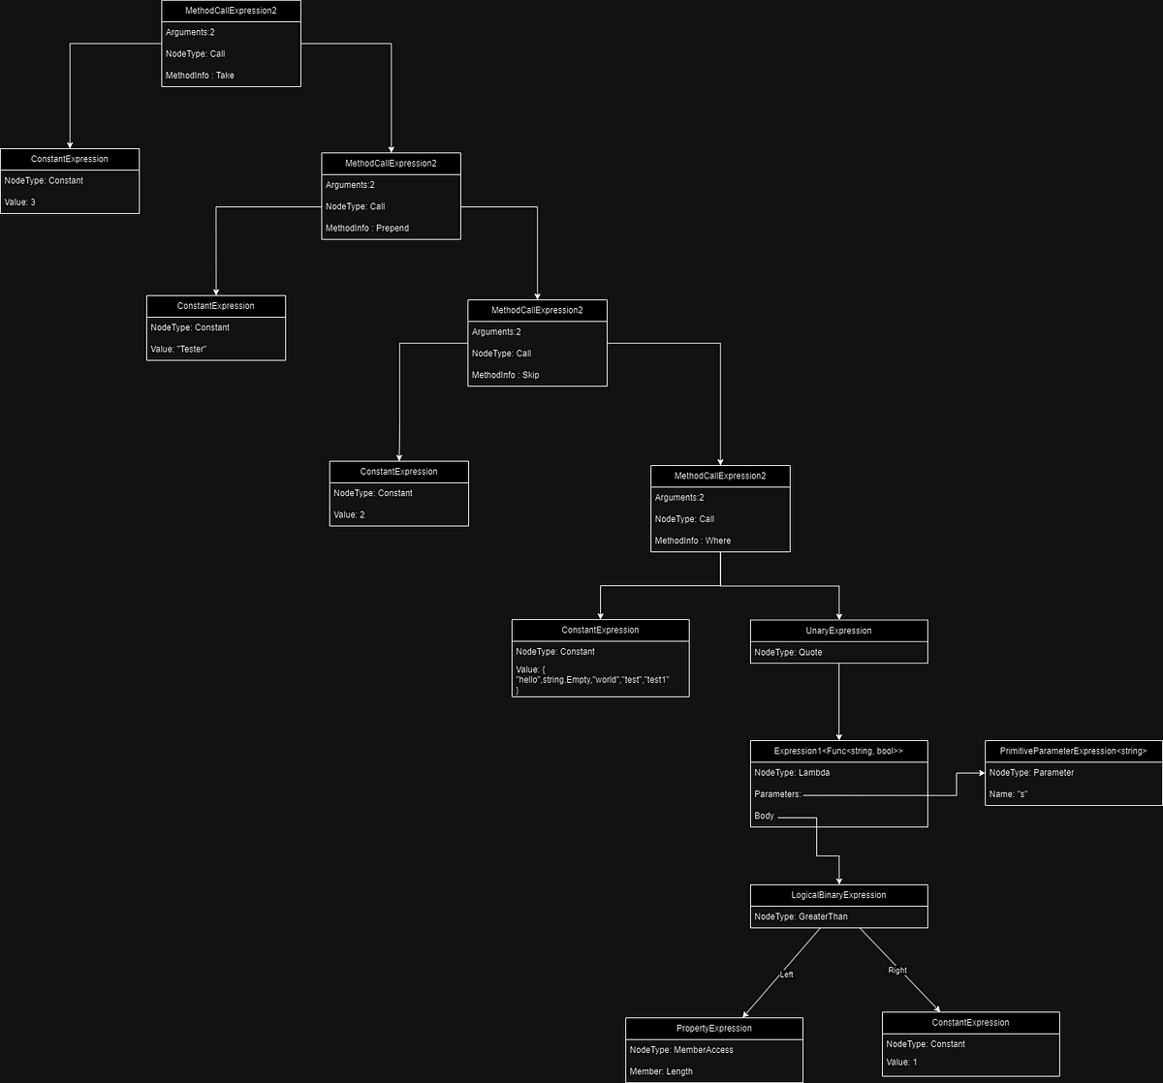
C# Example

Slide 37
Thank You

